Slide 1
CCS Release Management TDM Guide
Sara Kamal

Slide 2
Agenda
Release Introduction
Release schedule
Release Governance
Release RAGs
Journey/Process work-flow
Features
Delivery work item
Function
Feature, Delivery & Function State Synchronization
How to be committed into a release?
Change Requests
FUT, CJT & ELS/Hypercare

Slide 3
Release Introduction

Slide 4
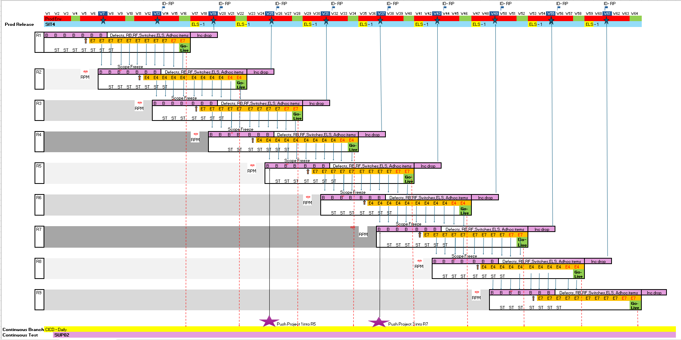
CCS Helix –Model
 | CCS Express | CCS Helix
Go Live | Every 3 weeks - Total 15 releases | Every 6 weeks – Total ~8 releases
Build window | 5 weeks | 7 weeks
Total SIT window | 5-7 weeks | 11 weeks
Clean SIT | 1 week | 6 weeks
SIT Clean Run | 1 week | 2 weeks
Continuous branch | Only for churchill | For eligible Long running projects
Predictable
Extended Build & Test Cycle provides with a predictable delivery
7 week Build Cycle
9 Week Continuous Test Cycle
Go Live every 6 weeks
Incident Drop planned in between releases
Optimum
Less No of releases (~8 as opposed to 15 with CCSXpress per year)
Less Parallelism (Build overlap only 1 week between Releases R and R+1)
Time To Market
Release frequency changed (6 weekly as opposed to 3 in CCSXpress)
Potentially a better TTM from Business Value point of view with predictable delivery.
What is CCS Helix?
The new CCS Helix release model consists of 2 main parts:
The CCS Release go-live cadence will change from every 3 weeks to every 6 weeks, with an In-Life drop for PBIs (Bugs) in-between.
There will be a Long Running Branch (LRB) for larger projects which are developed in parallel to the 6 weekly cadence until fully developed, tested and ready for deployment; when they will move to the next regular release for final testing and deployment
Build | SIT | Go-Live | ST

Slide 5
Release Schedule

Slide 6

High Level Timeline – CCS, ECS & Digital || Financial Year 2026/27
Consumer CCSXpress releases are every 3 weeks, while CCS Helix are every 6 weeks – Where possible
When planning releases and their phases, we consider a range of restrictions and factors such Holidays, Device Launches, Billing, Environments & Resources; adjusting as needed after consultation with a range of stakeholders
A release delivers new functionality, platform upgrades, enhancements and fixes
CCS (Consumer) Releases are above the timeline, with ECS (Enterprise) and Digital PI durations below the timeline
CCS, ECS and Digital: Financial Year 2026/27
CCS
26.4+26.5
CCS
26.6A
Helix
TRN 1
Helix
TRN 2
CCS
26.8
CCS
26.10
CCS
26.11
CCS
27.1
CCS
27.2
CCS
27.4
Tue 19 May
Tue 2 Jun
Tue 7 Jul
Thur 13 Aug
Tue 25 Aug
SD
26.9
Tue 6 Oct
SD
26.10
Tue 17 Nov
SD
26.12
Tue 12 Jan
SD
27.2
Tue 23 Feb
SD
27.3
Tue 6 Apr
Tue 22 Sep
Tue 27 Oct
Tue 8 Dec
Tue 2 Feb
Tue 16 Mar
Apr 26
Jun 26
Aug 26
Oct 26
Dec 26
Feb 27
Apr 27
May 26
Jul 26
Sep 26
Nov 26
Jan 27
Mar 27
Fri 17 Apr
Fri 15 May
Fri 12 Jun
Fri 10 Jul
Fri 7 Aug
Fri 4 Sep
Fri 9 Oct
Fri 13 Nov
Fri 11 Dec
ECS 26.4
ECS 26.5
ECS 26.6
ECS 26.7
ECS 26.8
ECS 26.9
ECS 26.10
ECS 26.11
ECS 26.12
Digital – PI 41 26 Mar 2026 to 24 Jun 2026
Digital – PI 42 25 Jun 2026 to 23 Sep 2026
Digital – PI 43 24 Sep 2026 to 06 Jan 2027
Digital – PI 44 07 Jan 2027 to 24 Mar 2027
Shape Key: Light Blue = CCSXpress, Light Green = CCS Helix, No Shape = Stability Drop, Gold = ECS, Pink = Digital, Purple = Transition
Notes:
This slide is for presentations, such as Op Reviews

Slide 7
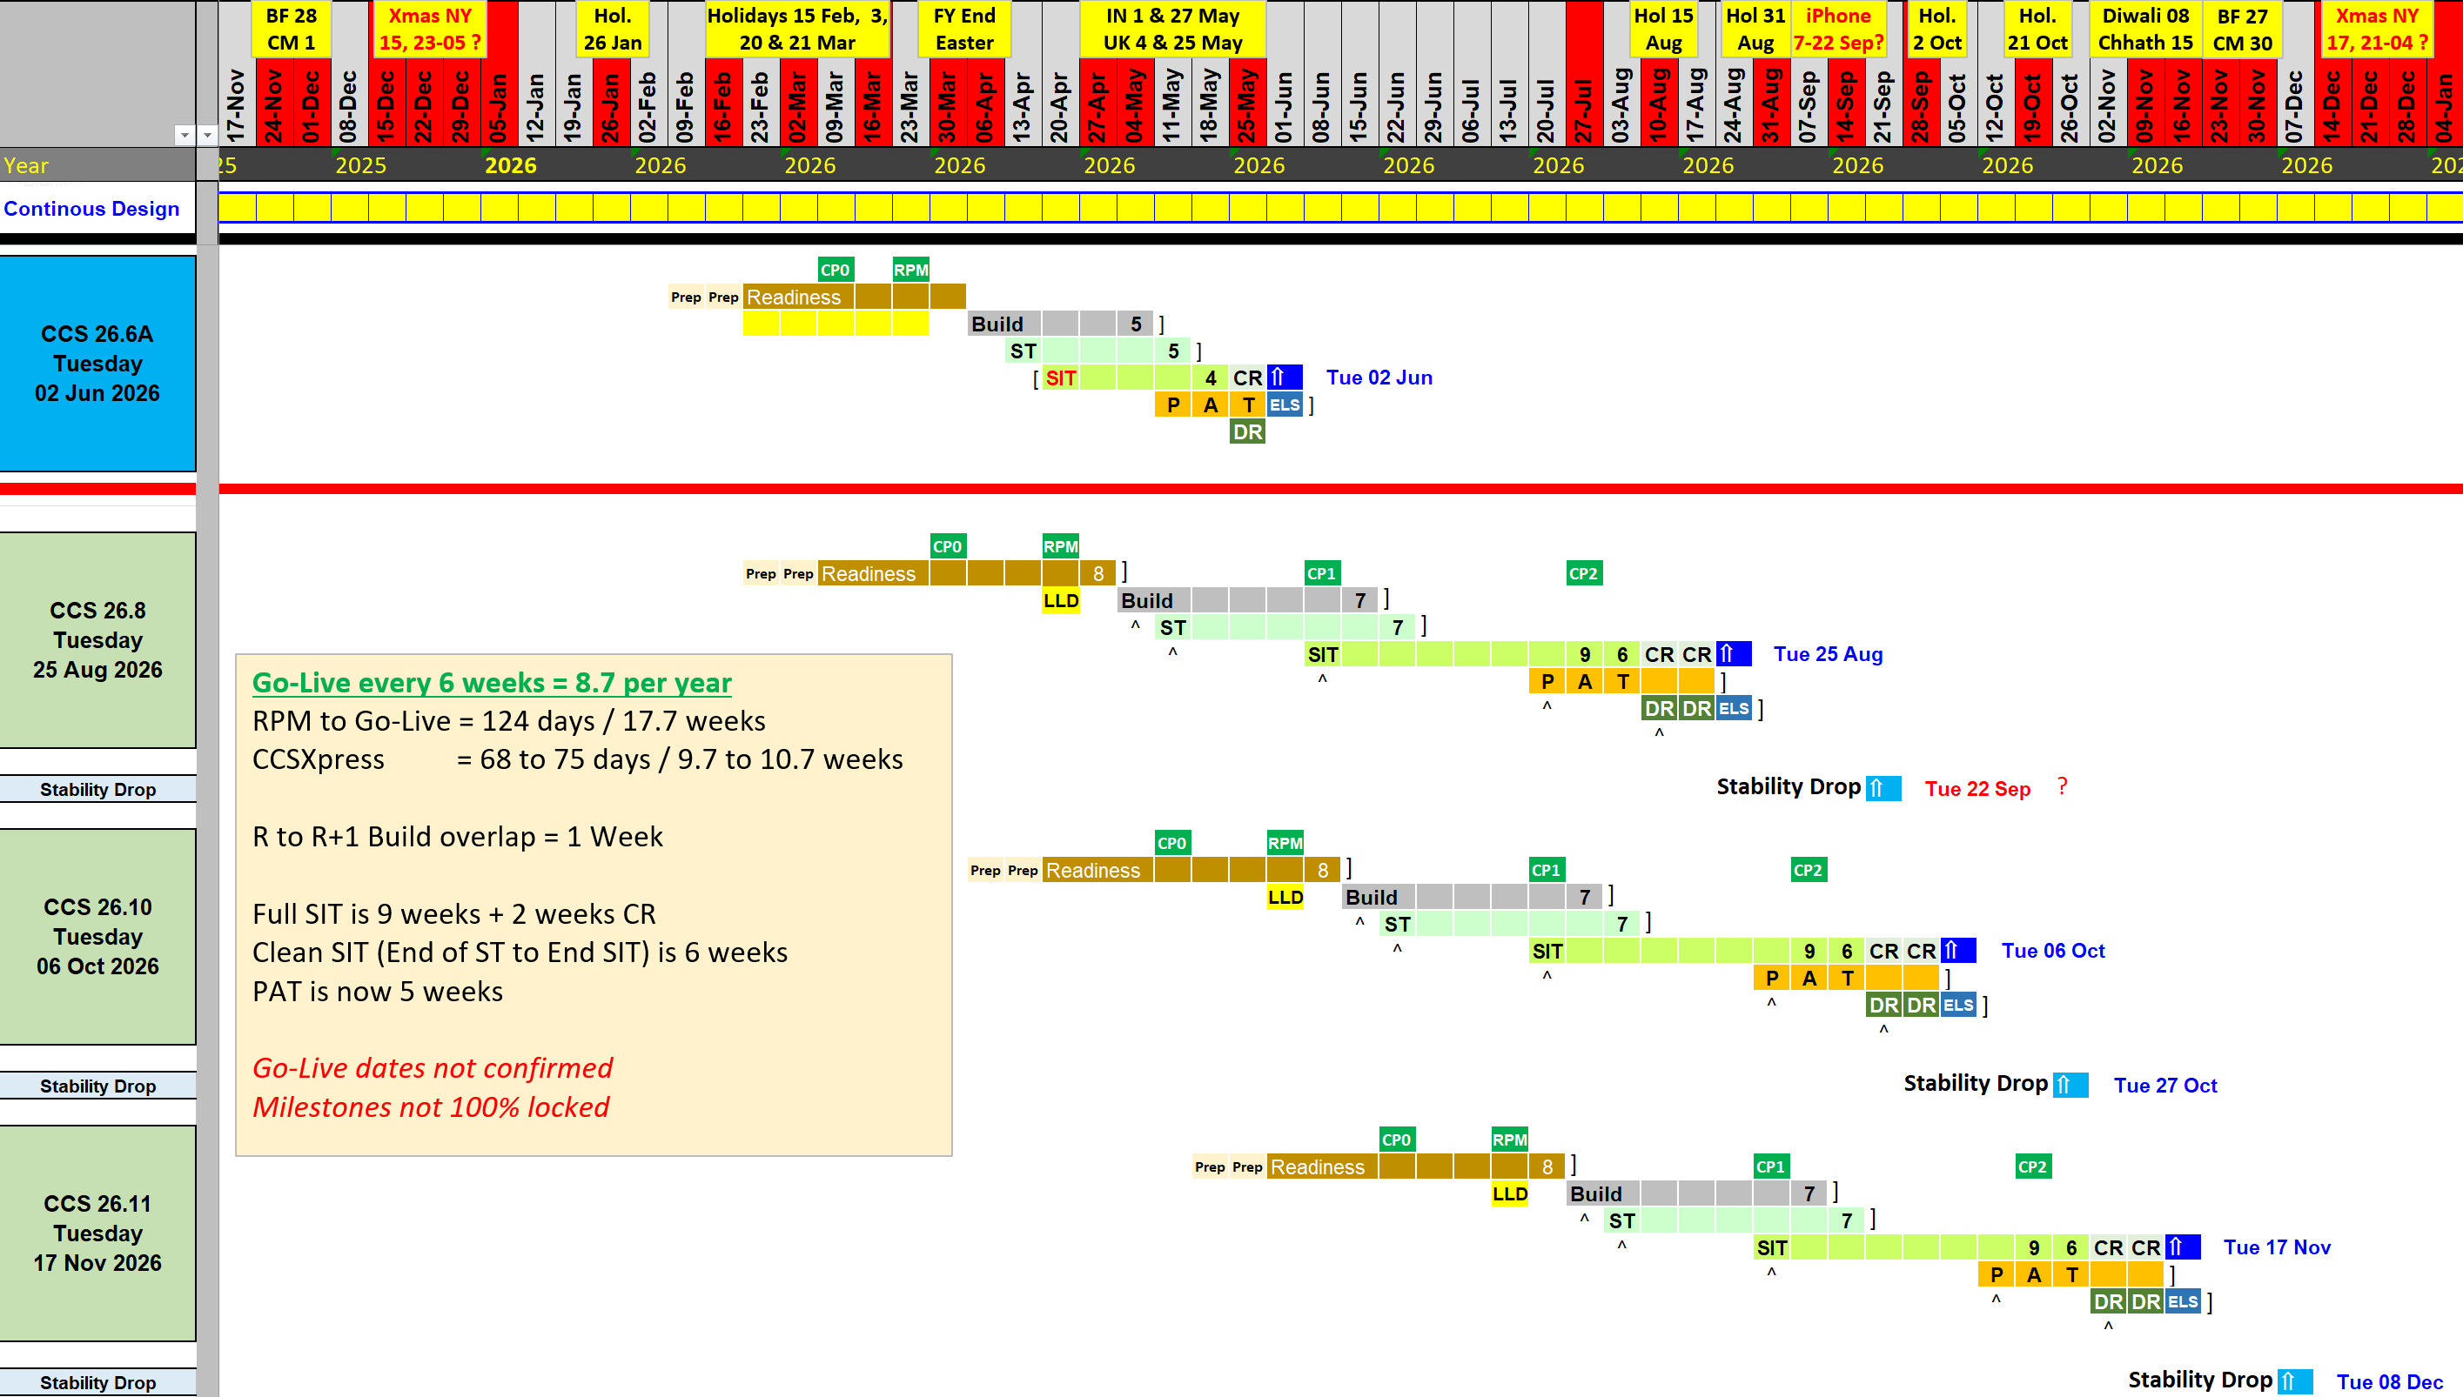
CCS Helix – Release Schedule

Slide 8
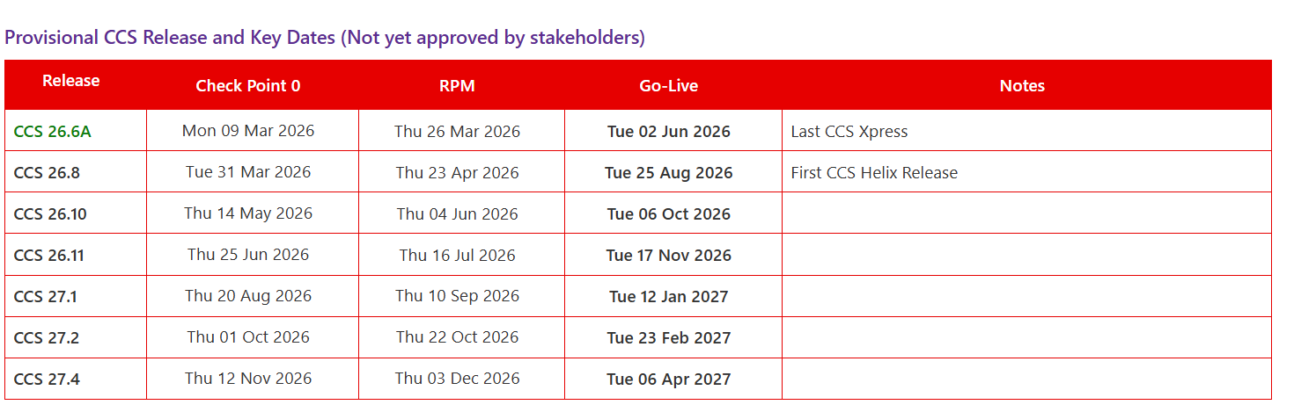
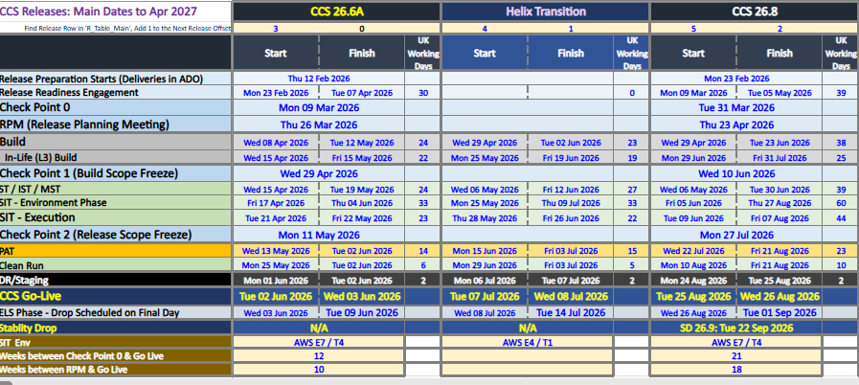
Schedule || Table Views
Detailed Schedule is CCS Helix - Schedule.xlsx

Slide 9
Release Governance

Slide 10
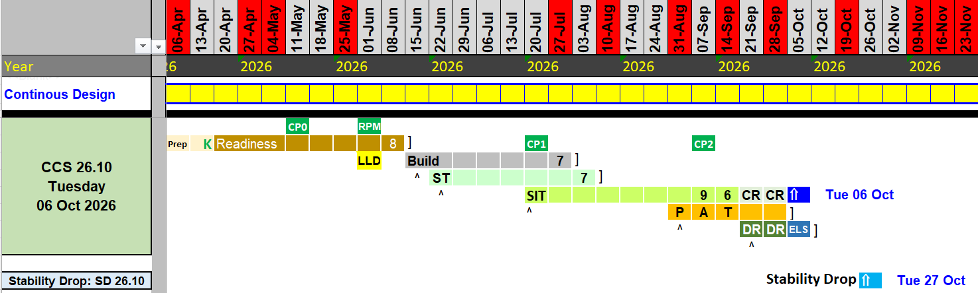
Governance and Demand Process
Start of Release Readiness
Objective: Alignment of an ADO Delivery to the Release the project is targeting for support
Entry criteria: Epic in P2D ADO, Feature & Delivery in RM ADO, Functions aligned to the correct impacted applications
Audience: VF3 E2E RM, Domain RM, Factory RM, Delivery Managers, Test
Check Point 0 (CP0) – Release Ready
Objective: Assess candidates targeting the Release for their readiness
Entry criteria: All Major Approvals done (E2E HLD & VROMs), Delivery plans provided, LLDs will complete by RPM, with mandatory release readiness criteria filled – See the Release Readiness - ADO Checklist
Output: for ready candidates, moving out those not ready (Red)
Audience: VF3 E2E RM, Domain RM, Factory RM, Delivery Managers, Test
Check Point 1 (CP1) – Build Scope Freeze
Objective: Release scope freeze for build
Entry criteria: Deliveries (including any component subtasks) & In-Life scope prioritised by Business value; correct L1 & L2 analysis complete, component delivery dates and test plan complete
Output: Confirmation that further build requests are being considered for the Release
Audience: VF3 E2E RM, Domain RM, Factory RM, Delivery Managers, Test
Release Planning Meeting (RPM)
Objective: Commit candidates that has fulfilled the complete readiness criteria, where capacity permits, with capacity allocated accordingly
Entry criteria: Low-level designs (LLDs) must be completed by RPM, Third party dependencies are aligned & prior to SIT start date
Output: Commit ready candidates to the release, moving out those not ready (Red)
Audience: VF3 E2E RM, Domain RM, Factory RM, Delivery Managers, Test
Check Point 2 (CP2) – Final Scope Freeze
Objective: Final scope freeze for Release
Entry criteria: No entry criteria, but this is the final checkpoint where no further candidates will be considered.
Output: Scope closed for the Release
Audience: VF3 E2E RM, Domain RM, Factory RM, Delivery Managers, Test
Change Requests (CRs)
Objective: Review late changes into the release post-RPM
Entry criteria: Completion of the ADO Change Request
Output: Accepted or rejected based on reasons given, business urgency, risk and impact
Audience: VF3 E2E RM, Domain RM, Factory RM, Delivery Managers, Test

Slide 11
Check Point Zero – Release Ready
Objective: Assess whether candidates targeting this Release are ready to move forward, or should target a later release or move to the backlog
Participant | Input (Actions Done) | Output (Actions to do)
VF3 E2E RM | Assessed and RAG’d candidates for their readiness Reports and dashboard to convey status | Continue with Green and Amber candidates Move Red candidates to Backlog Publish CP0 comms
Domain RM & Factory RM | VROMS approved Delivery plans Dependencies confirmed | N/A
Delivery Managers | ITDA, E2E HLD & VROMs approved ADO Epic, Feature, Delivery & Functions – Mandatory fields completed Test & VES teams engaged – SR / EQF forms raised Engaged all impacted domains | Green candidates move forward For Amber, action any outstanding points Replan any Red items moved to backlog
Test (SIT & PAT) | SIT Test Manager assigned SIT planned dates Update ADO’s Test, Environment fields | For Green & Amber candidates, kick-off test assessments Finalise ADO’s Test, Environment fields
Environments | Confirm Environments to be used for this release | Highlight risks, challenges & dependencies, impacting env. readiness
Entry criteria:
Project ITDA, E2E HLD & VROMs signed off
ADO 100% complete – EPIC, Feature, Delivery & Functions. See the Release Readiness - ADO Checklist
Delivery plans provided
LLDs will complete by RPM
VATS and VES engaged
Dependencies are confirmed and final
Output:
Continue with Green and Amber candidates
Move Red candidates to Backlog
Publish CP0 outcomes
Test assessment kick off for Green & Amber candidates
Mandatory Audience: VF3 E2E RM, Domain RM, Factory RM, Delivery Managers, Test (SIT & PAT) & Environments (VES)

Slide 12
Release Planning Meeting (RPM)
Objective: Commit candidates into the Release, where all readiness requirements are met, including Test assessments
Participant | Input (Actions Done) | Output (Actions to do)
VF3 E2E RM | Assessed and RAG’d candidates for their readiness | Commit Green candidates Amber candidates remain for 1 working week Red candidates are moved to the Backlog Publish RPM outcomes
Domain RM & Factory RM | VROMS approved Delivery plans Technical dependencies highlighted Low level design complete | Ensure Domain and Development teams proceed with the scope committed
Delivery Managers | All release readiness requirements are met | Close outstanding actions with Amber candidates within 1 working week Address issues with Red candidates, and target a future release
Test (SIT & PAT) | Test assessments completed Finalise ADO’s Test, Environment fields | Commence test preparation Test quotes Issued
Environments | Review EQF Highlight risks, challenges & dependencies impacting environment readiness | Proposed plans & uplift timelines for VES owned apps
Entry criteria:
Delivery plans are available at least 4 working days before RPM, for VF3 E2E RM & Test Assessment
Dependencies managed – 3rd Party apps, Projects, Connectivity, etc.
Consumption plans
SIT planed dates
Test assessments concluded, with capacity available
Output:
Commit Green candidates
Amber candidates remain for 1 working week
Red candidates are moved to the Backlog
Publish RPM outcomes
Mandatory Audience: VF3 E2E RM, Domain RM, Factory RM, Delivery Managers, Test (SIT & PAT) & Environments (VES)

Slide 13
Check Point 1 – Build Scope Freeze
Objective: Freeze build scope for new business demand, no new build requirements considered
Participant | Input (Actions Done) | Output (Actions to do)
VF3 E2E RM | Review execution progress | Confirm there are no further build requirements
Domain RM & Factory RM | Confirm final release build scope Highlight risks via RAID | Align build scope as required Action any RAID items
Delivery Managers | Raise any scope changes or dependency issues | Communicate scope changes
Test (SIT & PAT) | Raise any challenges to the start of testing | Align execution resources
Environments | Raise any issues regarding plans for new interfaces | Review environment plans following any scope changes
Entry criteria:
Development is complete or already in progress
Output:
Final build scope for CCS Stack, Domains, Digital & Third Parties = Everything
Review any scope changes
Mandatory Audience: VF3 E2E RM, Domain RM, Factory RM, Delivery Managers, Test (SIT & PAT) & Environments (VES)
Optional Audience: Domains

Slide 14
Check Point 2 – Final Scope Freeze
Objective: Final release scope freeze
Participant | Input (Actions Done) | Output (Actions to do)
VF3 E2E RM | Review candidates at risk of not completing testing in time for release | Final scope list for release, including consumption plans Agree mitigation plans with projects where applicable For spill-over scope, propose future releases
Domain RM & Factory RM | N/A | Switch off plans/rollback efforts and regression impacts
Delivery Managers | CJT & DVT Packs | Confirm project status to business Where scope moved out, revise project plans
Test (SIT & PAT) | List of candidates at risk | Confirm potential deferrals from release
Environments | N/A | N/A
Entry criteria:
Identify candidates at risk
CJT & DVT Packs to be requested from projects
Output:
Switch off plans/rollback efforts to be confirmed
Publish final scope for the release
Revise project plans for spill-over scope
Final consumption plan aligned based on testing outcomes
Mandatory Audience: VF3 E2E RM, Domain RM, Factory RM, Delivery Managers, Test (SIT & PAT) & Environments (VES)
Optional Audience: Domains

Slide 15
Change Requests
Objective: Review late changes into the release post-RPM
Participant | Input (Actions Done) | Output (Actions to do)
VF3 E2E RM | N/A | Accept or Reject the CR
Domain RM & Factory RM | Approve VROMs Provide delivery plans | N/A
Delivery Managers | Complete ADO CR work item will all key information correctly completed Provide delivery plans in linked ADO work items | N/A
Test (SIT & PAT) | Test assessment completed | N/A
Environments | N/A | N/A
Entry criteria:
Completion of the ADO Change Request including – Reason for being late, Business justification, Impact from not proceeding, Value change brings
Approved VROMs and delivery plans
Test Assessment
Output: Accept or Reject the CR
Mandatory Audience: VF3 E2E RM, Domain RM, Factory RM, Delivery Managers, Test (SIT & PAT) & Environments (VES)
Optional Audience: Domains
The following types of CRs will be considered:
Technical CRs such as defect fixes that need a change in Low Level Design
Fall-outs from previous release due to open defects despite realistic project planning
The following types of CRs will not be considered:
Due to project missing readiness timelines
Due to late business requirements or requests

Slide 16
Engaging with Release Management
Approx. 2 weeks before Readiness starts, Features must move to the RM ADO, with child Deliveries created & populated:
The Feature should have its E2E HLD at least in Draft state, with impacted applications known, with Functions created and assigned to Domains
Early key fields of interest are:
Features: Stakeholders, E2E HLD status
Deliveries: Target Release, Consumption Plans, Business/Legal dependencies
Functions: T-Shirt sizes, VROM State, any delivery plans
Readiness is announced via email to Demand & Delivery DLs, plus TDMs named in those Features/Epics
The list of potential candidates is gathered purely from ADO, where Feature’s Deliveries are targeting that release
The readiness email will contain links to resources such as Dashboards, the schedule and key actions to complete before CP0 & RPM
Invites are then sent to all Delivery Managers to attend regular calls, at least weekly
If TDMs are unable to attend those calls, or projects are large/complex, or they are unsure of the process, they should schedule calls with Release Management. Either Vincent Stokell for training & process support or the release manager for that release for review & management
TDMs are asked to enter their ADO Feature link/url in the Teams chat window so Release team can discuss in order of who joined
Check Point 0 (CPO) :
Candidates RAG’d as Red are often moved to the backlog, for the TDM to move to a later release or come back if prompt & significant progress
After CP0, new candidates targeting this release, or major changes of scope for existing candidates, require a Change Request
The Release Planning meeting (RPM) :
Green (Release Ready) items will be committed (subject to capacity) for Build, Test, Deployment etc., as appropriate to its consumption plan
Amber items may remain for a few more days if designs and other actions will be completed in time
Red items will be moved out to the backlog, except in exceptional circumstances such as a late regulatory item which must go in this release
The Release Readiness calls end after RPM, when the Daily Build and Test status calls start.
While Delivery Managers are not specifically invited, they are welcome to attend those daily status calls

Slide 17
Check Point 0 & Release Planning Meetings (RPM)
The Check Point 0 & RPM calls are usually repurposed readiness calls
They key purpose is to convey the release RAG, with minor clarifications from the TDMs.
Due to the number of epics, time constrains and the large number of people in these calls, RM will not discuss new epics or deep review/update existing epics
Where Amber or Red; refer to this guide, the demand and governance guide, the kick-off email and our release status updates
At Check Point 0:
Before CP0 RM Release RAG candidates, with Red Candidates typically moved to the backlog after the call
TDMs are expected to attend, especially where not on track, for input into the Release RAG decision
From CP0, all new candidates or candidates previously moved out will only be considered when:
They are fully release ready (approved designs, etc.) with ADO accurate and up to date so Release team can make an assessment
Then they submit a correctly completed Change Request with all the info requested
The TDM (or a nominated representative) attends the Change Control Meeting
Candidates which are not accepted will be moved to the backlog for the TDM to target a later release
At RPM:
Attendance by TDMs at the RPM is not optional if their candidates are to be committed into this release
TDMs (or a nominated representative) are required to confirm no changes or risks, and answer any clarifying questions
Release team typically move out any Red candidates and may give Amber candidates an extra week or so be ready
Items not committed at RPM are at an increased risk of not being committed as resources may be allocated to other projects
See the Key Deliverables sheet in this guide and Release Readiness ‘Cheat Sheet’ on our SharePoint for details
For the purposes of Flux, all candidates committed after RPM+4 working days are considered ‘late’, with the reason recorded.

Slide 18
Release RAGs

Slide 19
Release Rags || Definitions
These are the criteria Release team use to typically use to determine the RAG for projects targeting a release
Early Readiness / Check Point 0
Red – Likely to miss the release Not confirmed as targeting the release; the business requirements or the E2E HLD are not final; Application VROMs have not started; Low-Level designs will not start before RPM. These candidates will moved out of this release to backlog, for the Delivery Manager to target a later release.
Amber – May make the release if there is capacity and deliverables can be brought forward Funding issues; The E2E HLD is approved, VROMs to be approved imminently with Low Level design due to finish before the Build phase
Green – Expected to make the release if there is capacity The E2E HLD & VROMs are approved, with low-level designs complete or due to complete before RPM
During Release Planning Week & Release Planning Meeting
Red – Not Ready for the Release Funding issues; E2E HLD and/or VROMs not approved; Low-Level designs not started; Too large to fit and needs further breakdown
Amber – May make the release if there is capacity and does not slip further E2E HLD & VROMs approved; Funding approved; Delivery plans final; Low-Level designs are progress; There are SIT, Environment or other open questions
Green – Committed into the Release or expected to commit within 7 days All designs & funding approved, Delivery plans final, Low-Level designs complete or expected to complete before build, no open issues
After Release Planning and Until Go-Live – Late Candidates or Committed Candidates with Scope Changes, Risks & Issues
Red – If new unlikely to be committed, if existing due to be removed There are blocking issues such as not enough time, capacity or resources; or too high a risk to the project or the release
Amber – At Risk of being declined or removed There are open issues, with the outcome unknown
Green – Committed with no known blocking issues There are no open issues or risks, or any open issues or risks are expected to be resolved in time

Slide 20
Journey / Process Work-Flow

Slide 21







High level journey – Visual
Overview of the key ADO projects and work item types that will be used as part of the Release Management lifecycle.
Please note that Change Control, RAID , Tasks and Bugs will be detailed in other documents
CCS Engineering ADO
Plan 2 Deliver ADO
Release Management ADO
Integration ADO
Data ADO
Programme
Feature (Spans Releases)
Function (Application Impact)
Moved here via button
Moved here automatically
Epic (Commercial Date)
Delivery (Per Release)
Created here
Other Work Items Vary By Domain
Feature (Spans Releases)
Function (Application Impact)
User Story
Task
Bug
Created here
Created here
Key Contacts:
Nicola Wootton
Key Contacts:
Vincent Stokell
Key Contacts:
CCS Engineering: Steve Karlsen
Data: Kevin, Susan
Integration: Parminder

Slide 22
High level journey - Summary
Within the P2D ADO Project:
In the early stages of the project, the Portfolio Planning teams create an Epic to plan the investment and capacity.
The Epic is where the allocated budget for the project and it’s forecast spend and actuals are tracked.
If you cannot find your Epic or if there are multiple for your project, ask the PMO for support, do not create your own
Features are then created as a children of the Epic
The Feature is where BAs do their analysis, capture acceptance criteria, work on the E2E HLD etc.
Without a parent Epic in P2D, Release Management will not have the data needed to manage and commit your Feature
Once the target release is defined, this Feature is then moved to the Release Management ADO.
Within the Release Management ADO Project:
Building on the previous point, once in the RM ADO, review your Feature, especially it’s State and the E2E HLD fields
Set the Feature’s Target Release to the Release that you expect to deploy all your deliverables
Create child Delivery work items, one for each release required for your Feature
For each Delivery, complete all key fields, especially the State, Description, Target Release and Consumption Plan
Now create child Function(s) within your Deliveries to capture application impacts, work or support.
Where the domain for that Function has adopted the Function work item, the Function will automatically move to their ADO Project
The Domain now takes over the ownership of this work item
Where the domain has not adopted the Function, it remains within the RM ADO Project
Ownership remains with the TDM, who works with the domain to keep the data in-sync with the domain’s tracking system

Slide 23
Detailed workflow who does what #1
The order of the steps is indicative and may vary depending on the project
A more detailed workflow of the Epic, Feature and Function, along with their typical roles
1
2
3
4
Activity: In P2D (Plan to Deliver) ADO raise the Project Epic
Activity: In P2D, the Backlog is defined and groomed via child Features
Activity: In P2D, update the Feature Target release (Final Release).
Then when the E2E HLD is in progress or close to that release’s kick-off, move the Feature to the Release Management (RM) ADO Project
Activity: In the RM ADO’s Feature, update the State, E2E HLD Fields & Links to Design Documentation, and all other fields for which you have data
Start
Responsible:
Product Owner/Business Owner
Group portfolio manager
Responsible:
Group Business Analyst/stakeholder
Product Owner/Business Owner
Responsible:
Technical Delivery Manager (TDM)
Responsible:
TDM
Solution Architect
5
6
7
8
Activity: Within the Feature, create child Deliveries(s) for each Release required
Activity: Within each Delivery, update the Target Release, Consumption Plan and all other fields for which you have data
Activity: Within each Delivery, create child Functions for each application that is impacted or where domain support or SIT is required
Note: Functions will automatically move to the domain’s ADO if they support the Function work item or stay within the RM ADO if not.
If not, TDMs must keep the Function up to date, with domain support
Next Page
Responsible:
TDM
Responsible:
TDM
Responsible:
TDM
Responsible:
TDM
Key
Feature
Delivery
Function
State Change
TDM Activity

Slide 24
Detailed workflow who does what #2
The order of the steps is indicative and may vary depending on the project
A more detailed workflow of the Epic, Feature and Function, along with their typical roles
9
10
11
12
Activity: Workshop with domains to confirm and assess Function(s)
Activity: Request and progress VROM, updating T-Shirt & Function State. Note: If not small, consider splitting and scheduling in parallel, with multiple design/dev/test if possible
Activity: Within Function, Upload/Link to VROM, update State, PAD, BTD and other key fields
Activity: Where the VROM is not created by a domain, the Domain approves the VROM and updates the Function State
Continued
Responsible:
TDM
Domain Architect/Third Party Designer
Responsible:
Domain Architect/Third Party Designer
TDM
Responsible:
Domain Architect/Third Party Designer
TDM (If function in RM ADO)
Responsible:
Domain Architect
TDM (If function in RM ADO)
13
14
15
16
Activity: Financial Approval of costs, update Function State
Activity: Create and approve application Delivery plans, updating all relevant Function fields
Activity: Create and Approve Low Level Design (LLD), update Function design state and other fields
Activity: Commit to release and update Delivery State
RPM
Next Page
Responsible:
TDM/Budget Holder
Responsible:
Domain Delivery Manager/Scrum M.
TDM, RM & SIT to review
Responsible:
Domain Architect/Third Party Designer
Product Owner / Business Owner
Solution Architect & Dev may review
Responsible:
Release Manager
Key
Feature
Delivery
Function
State Change
TDM Activity

Slide 25

Detailed workflow who does what #3
The order of the steps is indicative and may vary depending on the project
A more detailed workflow of the Epic, Feature and Function, along with their typical roles
17
18
19
20
Activity: Update Function Build & ST progress States, Delivery Dates and other fields
Activity: Update Delivery SIT progress state
Activity: Update Delivery State Ready to Deploy, validate Consumption Plan
Activity: Combined Scope Report, Go/No Go Presentation Deck
Continued
Responsible:
Domain Delivery Manager/Scrum M.
Responsible:
SIT Team
TDM to review
Responsible:
Release Manager
SIT Team & TDM to review
Responsible:
Release Management, Deployment Team, SIT,
21
22
24
23
Go
No Go
Go Live to Production
Activities:
Set Delivery State to Deployed
Set Function State to Deployed
Set Feature State to Deployed (Where applicable)
Activity: ELS runs for 1 week, with Bugs logged in the Release Management ADO
Done
Responsible:
Release Management, Deployment Team, SIT, Domains, ???
Responsible:
Release Management
Domain Delivery Manager/Scrum M.
TDM (Where applicable)
Responsible:
Release Management
Key
Feature
Delivery
Function
State Change
TDM Activity

Slide 26
Feature / Delivery / Function || State Ownership & Synchronisation
This slide is a guide to who is responsible for Feature, Delivery and Function Work Items & States, which do vary by teams.
Who Owns and Manages which Work Items and their States:
Features are owned and managed by Delivery Managers
Deliveries are initially owned and managed by Delivery Managers, with Release Management, SIT and Deployment taking over once Committed.
Some States are automatically set – See Right
Functions hosted within a Domain ADO are owned and managed by the Domain
Functions hosted within the Release Management ADO are owned and managed by the Delivery Manager, with support from the Domain
As another resource (ADO, SharePoint, Tool) will likely contain the depth and detail, Release team ask that RM hosted functions are linked to that resource (An ADO Link or Comment URL) with the State, Delivery Dates and only key fields maintained in the Function.
Release team sync down these States, from Feature to Function, for CCS Engineering only:
ITDA
E2E HLD
Release team sync-up these States, from Function to Delivery:
VROM
Design in Progress
Build in Progress
ST in Progress
Domains vary in which states and sub-states they support, and which they sync with the parent Feature and/or the Delivery.
Release team sync down these States, from Delivery to Function, for CCS Engineering only (Nov 2024):
SIT in Progress
Ready to Deploy
Deployed
Note: All other States are manually set by their owners

Slide 27
Features

Slide 28
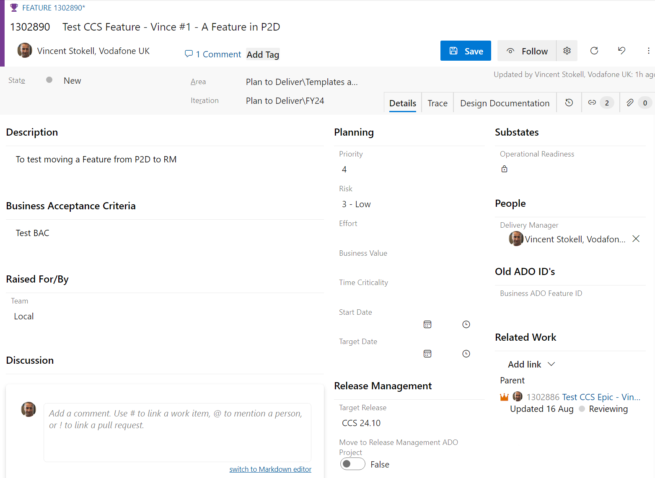
How to update the Feature in P2D
Feature
Identify your Features (in P2D) that are targeting a CCS release
If you do not have Features, work with your solution architect to identify and have these created.
Ensure the Feature is linked to a parent Epic in P2D.
Review and update the Description and Business Acceptance Criteria for the feature.
Then Review and Update the Planning Fields
Update the Delivery Manager for this feature
Select the Target Release for this feature
Where a Feature spans releases, this must be the final Go-Live release.

Slide 29
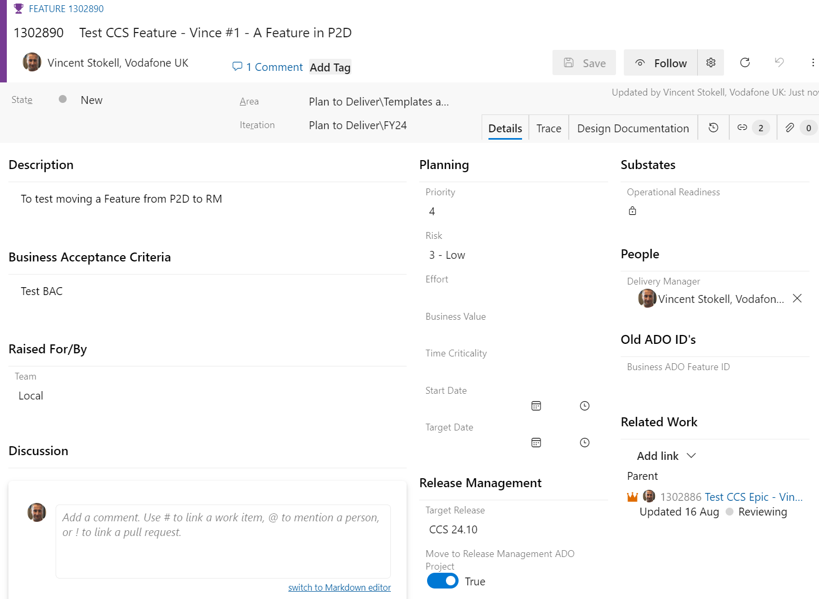
How to Move a Feature from P2D to RM ADO
Feature
Move the Feature from the P2D ADO to the RM ADO, via the ‘Move to Release Management ADO Project’ button on the P2D Feature form​
Save and after approx 5 mins when the area path changes, update the Feature’s State & E2E HLD fields​ (Next Slide)
To be sure you’re looking at the RM ADO instance of a Feature, which is different, click the Feature Number (Top Left) and check that the URL Changes to https://dev.azure.com/vfuk-digital/VF%20UK%20IT%20-%20Release%20Management
Set the Toggle to True and Save, to move the feature from Plan to Deliver to RM ADO.

Slide 30
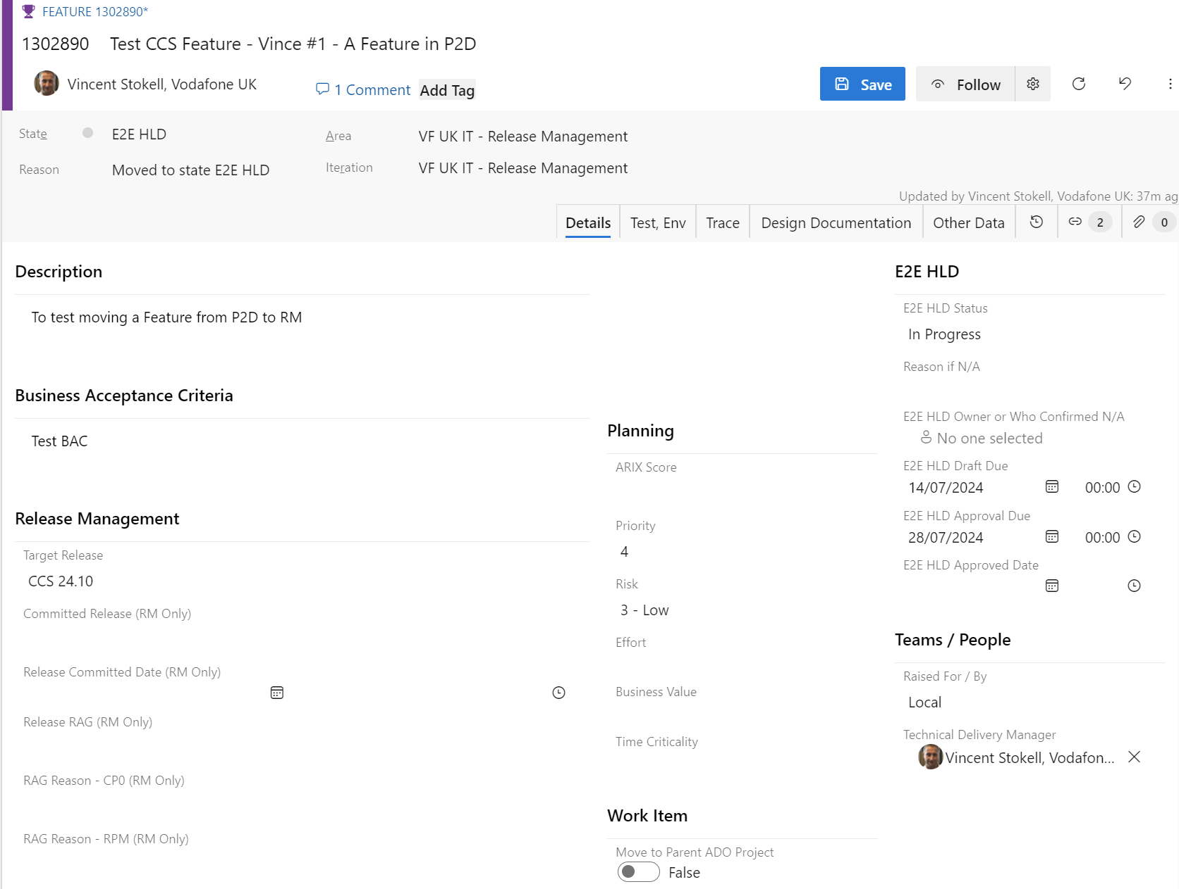
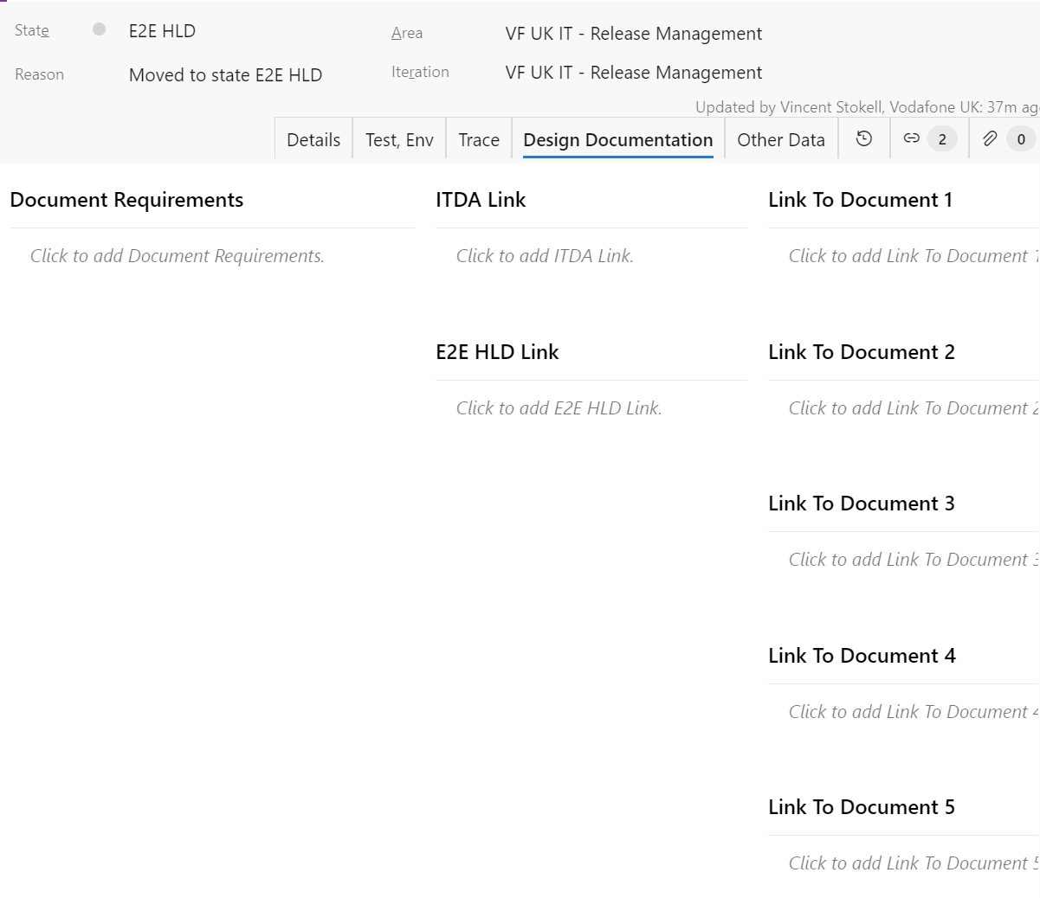
Updating a Feature in RM ADO || Key Fields – Details & Design Tabs
Feature
These key fields are critical for RM and other stakeholders to assess your Feature and work with it
Where these fields are not completed, your feature is likely to be RAG’d Red at CP0 and moved out of the release
As E2E HLDs are C3 which is not allowed in ADO, only provide links, do not attach E2E HLDs
Update the E2E HLD Status and Dates
Verify the Target Release
ITDA and E2E HLD
Verify the Delivery Manager

Slide 31
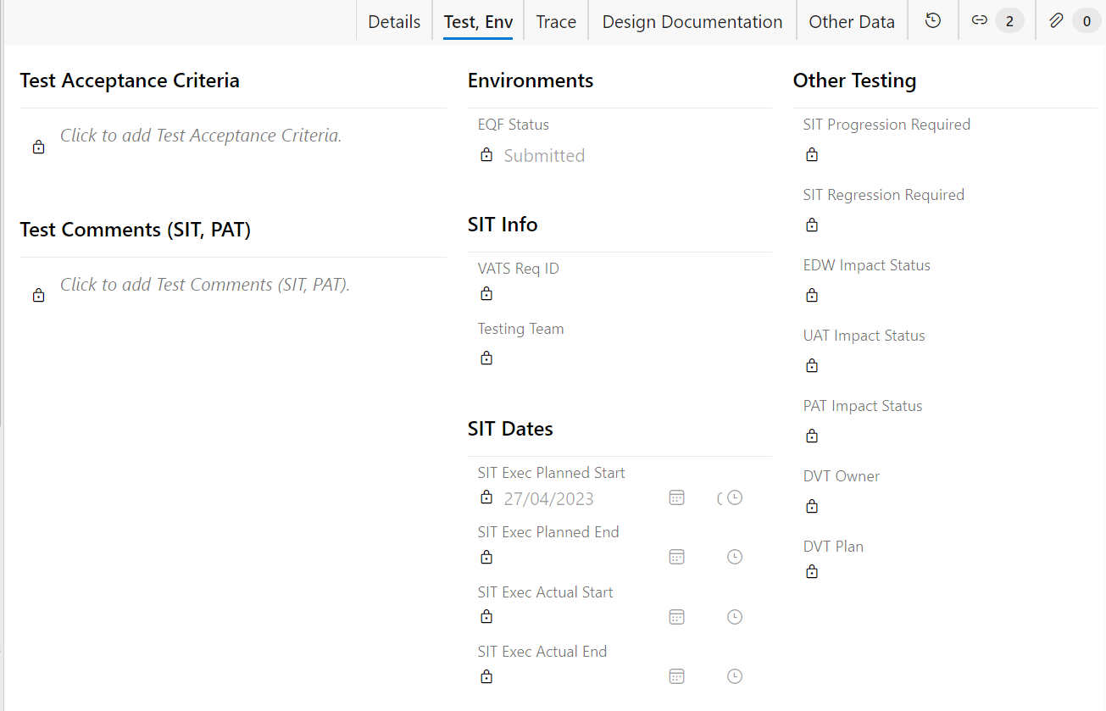
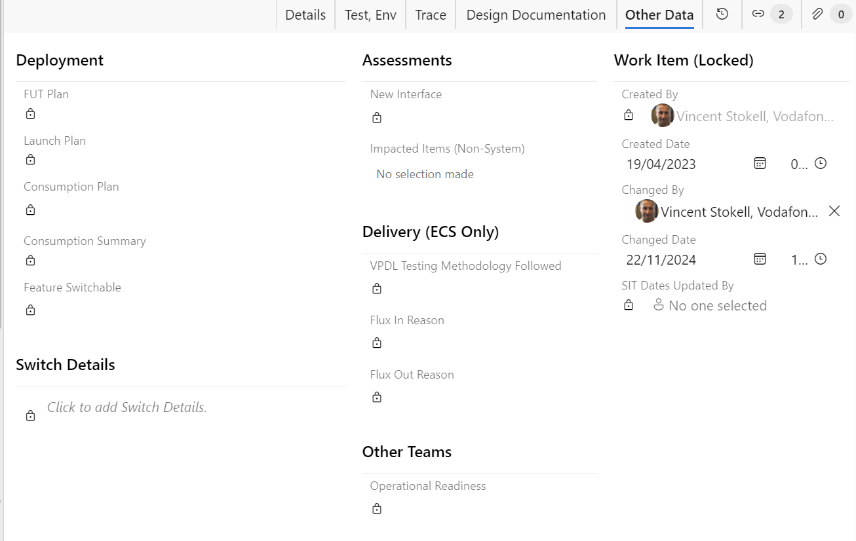
Updating a Feature in RM ADO || Locked Fields are Now in Delivery
Feature
Where Features target CCS 25.1 onwards, several fields are locked
The Delivery work item now tracks several fields which were added to the Feature when it moved from P2D to RM ADO
Those fields are needed for Features up to CCS 24.12 and will be unlocked/available for those releases
From CCS 25.1 onwards, as a Delivery is required (which contains these fields), these fields are locked in the Feature
Notes:
Use screenshots - Marine

Slide 32
Delivery work item

Slide 33
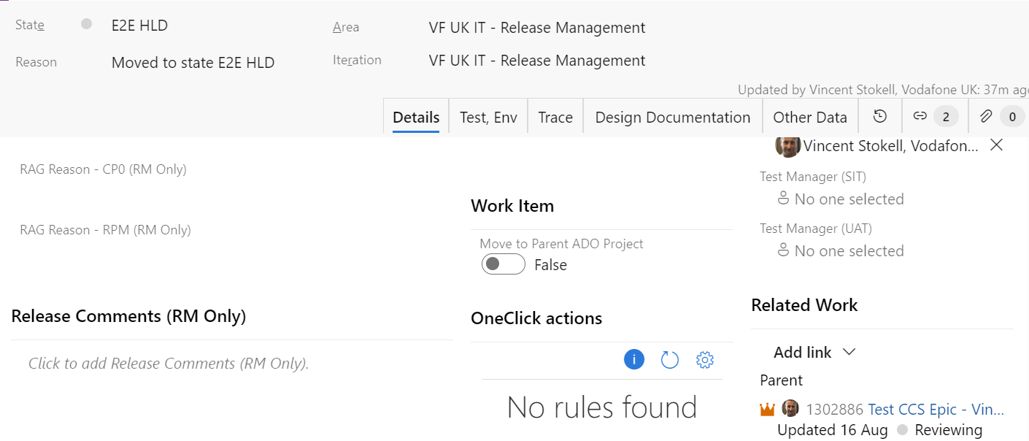
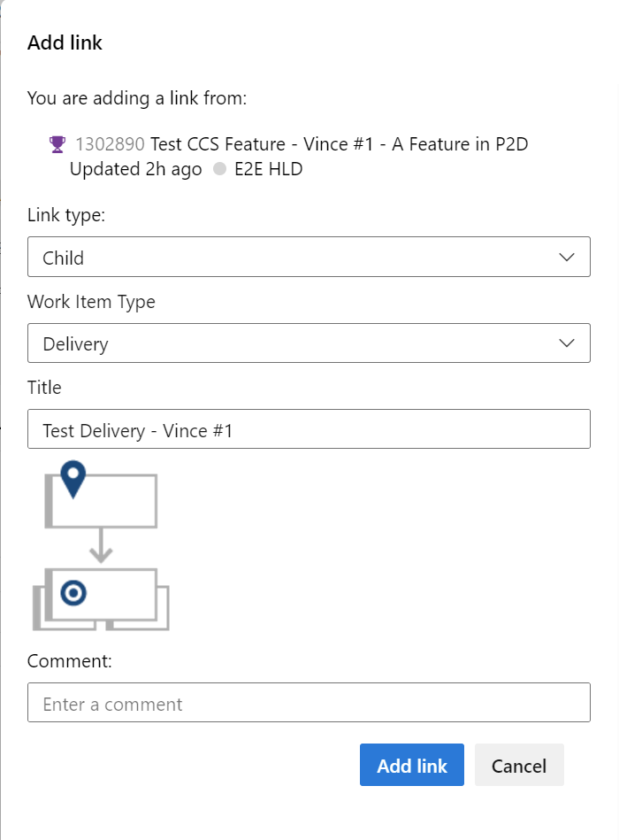
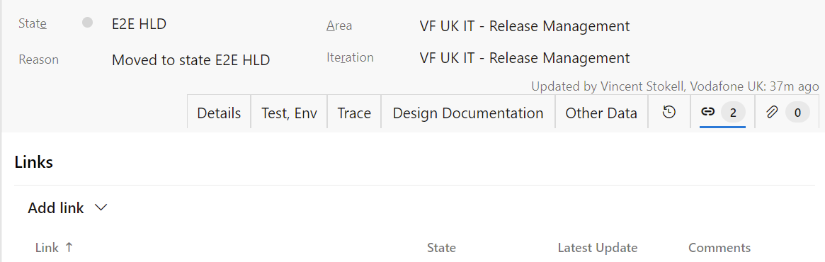
Creating a Delivery
Once in the RM ADO, add a child Delivery to your Feature via the Details Tab or the Links Tab
Enter a title which makes it easy to identify. E.G ‘EECC - One Touch Switch’, or ‘FMW - Docker Replacement Ph1
Then click Add Link which will create the Delivery, which you then edit and Save
#2 Add Link Dialog
#1 Via Details Tab
Add Link > New Item
Type = Child
Work Item = Delivery
#1 Via Links Tab
Add Link > New Item
Notes:
https://dev.azure.com/vfuk-digital/VF%20UK%20IT%20-%20Release%20Management/_workitems/edit/1280093
https://dev.azure.com/vfuk-digital/VF%20UK%20IT%20-%20CCS%20Engineering/_workitems/edit/1281574

Slide 34
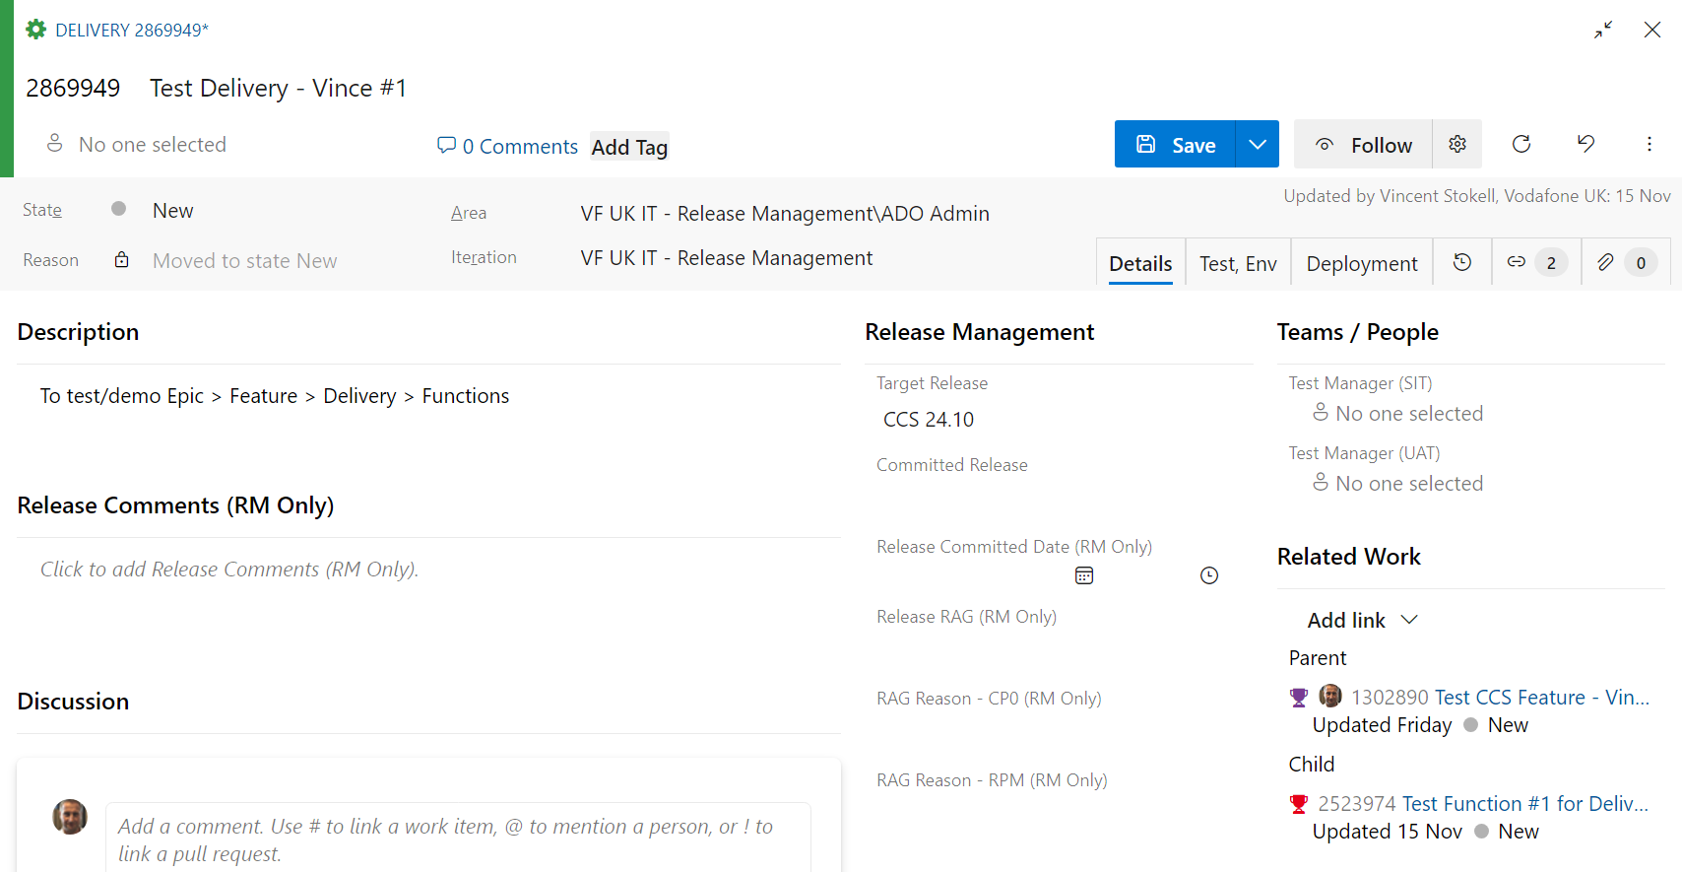
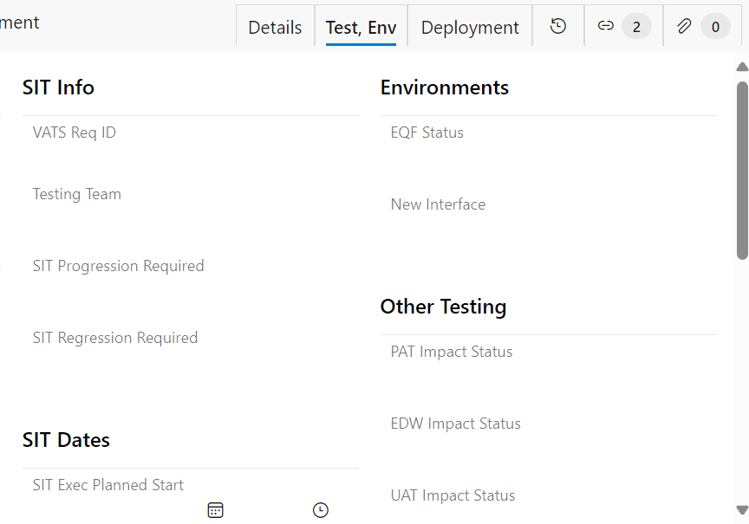
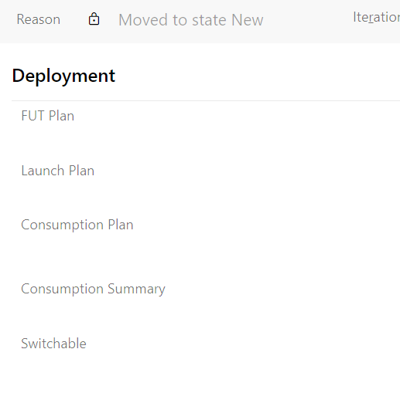
Updating a Delivery || Key Fields
Several Delivery fields are completed by other teams, these are the key fields for TDMs to complete
Details Tab: Target Release, Test Managers – SIT & UAT
Test, Env Tab: VATs Req ID, EQF Status, New Interface, PAT Impact Status, EDW Impact Status
Deployment Tab: Consumption Plan

Slide 35
ADO || Delivery Consumption Plans
The consumption plan field in ADO guides stakeholders on the Project’s intent for the state of the Delivery at Release Go-Live.
The application impacts (ADO Functions) also include Switches (Next Slide), which are set independently of the Feature, to compliment as needed
Value | Description
With Release | A normal deployment, going live to agents and customers
FUT | Friendly User Trial - Available to selected agents or internal/external customers
Switched-Off | This functionality is in production, switched off, not available to agents and customers.
Dormant | This functionality is in production, but not used until another system, app or service implements or calls it at a later date
Rolled Back | The code changes will be rolled back from this release
Design/Build/Support Only | Will be designed and/or built in dev environment only, not deployed to production, OR consultancy type of support
Descoped | Will be removed, and recorded as Flux-Out
Post-Release Future Deployment | Deployed after this release and before the next release
Pre-Release | Deployed before the main release Go-Live - Mainly 3rd party applications
DVT Only | Deployment Verification Testing only - Will not be deployed
POC Only | Proof of Concepts are not deployed to production. They are built in a dev environment only, and only available to internal users
Test Only | There is no new functionality delivered; signifies continuation of testing for features already delivered in previous releases (no roll-forward/no switch-on required)
Test Support Only | Test Support provided by CCS SIT team for testing being carried out by external Teams (Digital & 3rd Party), and may involve providing test data or extracting/sharing logs out to external teams

Slide 36
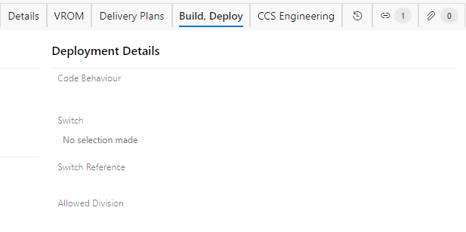
ADO || Application (Function) Switches
These switches are set by the domain, in consultation with Demand & Release
Domains may have differing switch fields in their ADO Project to suit their applications
The Switch field determines whether this code is enabled - Yes/No or restricted.
The Switch Reference drop down contains switch variable names which are defined by the build team to determine the behaviour of a sub-set of code. An example of their use would be running a specific routine when the switch value is true.
Value | Description
None | Value not set
On | The code is enabled which is the default behaviour where this switch is not set
Off | The code is disabled, in that its present but not run
Restricted | Only available to a subset of users, mainly to do FUT

Slide 37
Engaging with Other (Non-Dev) Teams || SIT, VES, PAT, etc.
See the https://vodafone.sharepoint.com/sites/CCSXpress SharePoint for links to other teams.
It is for those teams to document their engagement processes, but briefly:
Raise your engagement requests via their forms at the start of release readiness, before CP0
This is when your E2E HLD should be at least draft status and ideally approved
Where dates, delivery plans and final impacts are not confirmed, enter your estimates and add a comment to inform the team, stating when you expect to know and updating accordingly once confirmed.
The most common external (Non-Dev) teams to engage are:
SIT (VATs)
Environments (VES)
PAT
Operational Readiness

Slide 38
Functions

Slide 39
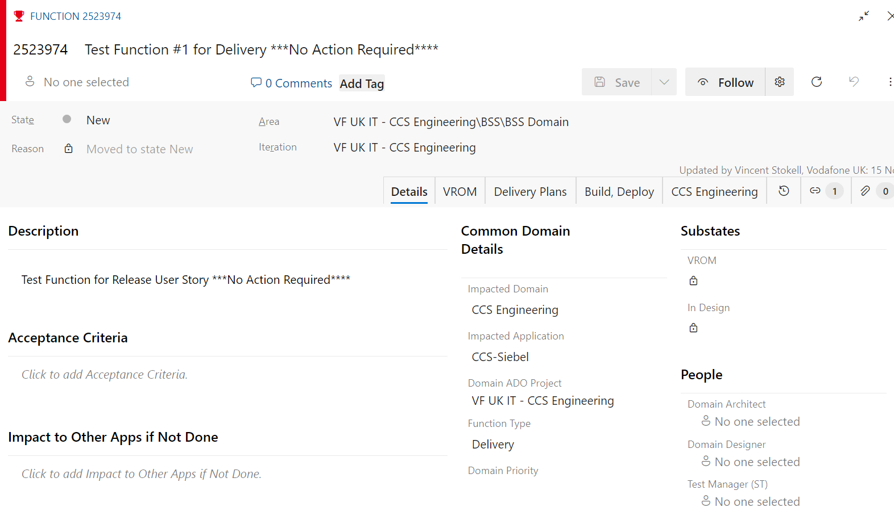
Functions || Key Fields
After adding child Functions to your Deliveries, these are the key fields for TDMs to complete
Description which may start basic, then expand as you work with the domain
Impacted Domain, which will then filter which applications/services you can choose in the Impacted Application Field
Impacted Application
Function Type
Each Application / Service is ‘Hosted’ in an ADO Project and if its domain contains a Function work item, Release team automatically move it to their ADO Project:
If Release team do move it, the Area Path will change to the Domain’s ADO Project and the Domain will maintain it
If Release team do not move it, the Area Path will remain as VF UK IT - Release Management and the TDM maintains with support from the domain/team/partner
If you cannot find your application, check the ADO How To SharePoint Page https://vodafone.sharepoint.com/sites/CCSXpress/SitePages/Azure%20Dev%20Ops%20(ADO).aspx which:
Contains an XLS which is easier to search
Instructions on how Release team add missing items

Slide 40
How to be committed into a release?

Slide 41
Project Scope & Status || Key Info
The Release Readiness calls are usually Monday, Tuesday & Thursday, starting 2 weeks before Check Point Zero, ending the week after RPM and before Build starts
Invites are sent to IT Delivery Domains/Teams, TDMs and the creators of those Features & Deliveries targeting the release
Delivery Managers are expected to attend at least weekly to provide updates, feedback, support, correctly documented & release ready
Due to release phases overlapping, the readiness, CP0 & RPM calls are usually at different times, typically 13:00 & 14:00
The aim of these calls is to work with the TDMs to understand the scope and status of the project’s feature(s) and then to steer and support that project’s deliverables into the release
Release team also need visibility of the following:
Item | Info / Examples
Work Item Codes | ADO Work IDs, ADO URLs (Preferred), VATS, VES engagement IDs, etc.
Stakeholders | Portfolio Manager, Technical Deliver Manager, Solution Architect & Test Manager, PAT, etc.
Status | The E2E HLD Status and approval dates, due or Key Deliverables
Impacted Apps | Which Apps are impacted – Usually from the ITA and E2E HLD and sometimes the Business Case
Size of Impact | The size of the impact, and if too large (See Size & Complexity) what options do we have, actions needed
Schedules | Is there a deadline for delivery and can it be split across releases
Dependencies | Is this dependant on something else going live or are there other items dependant on this

Slide 42
ADO || Committing Candidates into a Release
As well as the key deliverables, here is a guide to how RM review ADO in order to commit
Functions – 1st they check the following:
The State and Sub-State are as expected – At Least Design in Progress
Application VROM approved by the App. Designer & then financially approved by the Delivery Manager / Budget Owner
Delivery Plan present and the dates fit within the release
VROM PAD & BTD efforts are as expected
If these or other key values are not correct, it cannot progress until the relevant owner (TDM or Domain) actions
If any one Function is not correct or ready, the Delivery cannot be committed
Deliveries & Features
Key fields such as States, E2E HLD (Feature), Consumption Plan, Test Managers – See the Cheat Sheet
Release team check that SIT have confirmed capacity with SIT to be completed within the release schedule dates
Is there a parent Epic which provides Project level information, such as Portfolio, finance & delivery manager
If the above are present & correct:
Release team complete the Delivery’s Committed Release, Release Committed Date and any Flux values
Release team change the State to ‘Committed to Release’
Suggested Comment “Committed to Release @ dd Mmm yyyy”

Slide 43
CCSXpress ‘Cheat Sheet’ – Release Readiness for RPM
Objective: This ‘cheat sheet’ aims to assist delivery managers in preparing for RPM, where their scope is targeting the upcoming CCSXpress Releases. CCSXpress Governance is documented in the CCSXpress SharePoint
1
Identify whether any new env connectivity is required and raise to VES team at least 7 weeks before SIT start incl any new TIL stub in PAT Env.
2
Project ITDA, Business case and E2E HLD signed off
3
From your project epic in P2D ADO > Created Feature > Move to RM ADO > Create Functions (App impacts)
4
UX requirements identified, Halo design complete
5
Ensure catalogue/config subtasks are raised in line with WR in ADO, with delivery plan available in ADO Function
6
TIL delivery plan available in ADO Function and design complete
7
VROMS split into independently testable drops by Domain and approved by Factory
8
Factory delivery plans available in ADO Functions and designs complete
9
Ensure you have met the dependency management requirements listed here
10
Production Consumption Plan available in your ADO Feature (Up to CCS 24.12) or Delivery (From CCS 25.1)
11
Test team engaged and assessment complete (including PAT Assessment, "Only ST Sufficient" Assessment)
12
Requirements around Migrations, Patching and UIM Migrations agreed with Migrations Team.
13
Ensure NFR, PAT requirement updated in your ADO Feature (Up to CCS 24.12) or Delivery (From CCS 25.1)

Slide 44
Change Requests

Slide 45
Change Requests & Change Control || Overview
Once the Release Planning Meeting (RPM) is concluded, release scope changes are restricted and controlled for all new candidates, and changes to confirmed candidates. All such changes must be submitted via an ADO Change Request (linkd to the Delivery) that is then reviewed for approval by Release Management and other stakeholders. This Change Request review considers several factors, including but not limited to:
Whether this change is achievable, for example do we have enough time and/or resources
It’s impact on other candidates in the release
Customer impact and risks to quality
Typical valid exceptions/reasons for a late scope change, post RPM include:
Severe impact on this project
Legal
Financial
Regulatory
Company Strategy
Customer Impact
The following reasons are not valid except in exceptional circumstances which must be justified in detail for review by management/portfolios:
Being urgent or late, due to most change requests being urgent & late, as they would otherwise target the next release. If the issue falls within the above valid reasons, focus on those
Late decisions on issues known before RPM, especially those that were not shared earlier which could have been mitigated, planned or supported
Not understanding the process, as Release team have monthly new starter sessions, extensive documentation and dedicated support for several weeks prior to RPM

Slide 46
Change Requests & Change Control || Process
For post-RPM scope changes to Deliveries and Functions:
The TDM raises an ADO Change Request (CR) within the Release Management ADO Project, as a child of the item to the changed, which is usually the Delivery
If unsure how to do this, refer to the Change Request Section within our ADO User Guide
If functions are to be added, removed or changed, still create the CR as a child of the Delivery, but also create a Related link from the CR to those functions
No CR’s are entertained/reviewed/accepted for the release post Check Point 2 (CP2)
The TDM must ensure the Senior Portfolio manager signs-off an email, which is attached to the CR, providing justification and additional information (see below), which Release Management will review. Please include each of these four points:
Why it must be in this release and cannot align to other releases for which readiness maybe ongoing – See examples on the previous slide
Why it’s late and could not be ready in time, or not aligned to this Release during its Readiness phase ?
What measures are being taken by Delivery Leadership to avoid this nature of Flux in the future?
Negative impacts or risks should this change proceed
Providing all necessary information is included, Release team aim to respond within a week. Should information be missing, that will delay the decision while Release team seek clarification and increase the risk of rejection as time and resources ‘run-out’
Post review, Release Management will confirm whether the CR is Accepted or Rejected, along with any guidance or conditions
For your information - All new projects or scope changes which are aligned late after RPM are referred to as Flux-In
For each confirmed change, Release team capture the Flux-In reason for review and process improvement
The count of CR’s is a direct indication of Flux-In and there is a clear intent and focus within Vodafone to reduce these, ideally down to Zero.

Slide 47

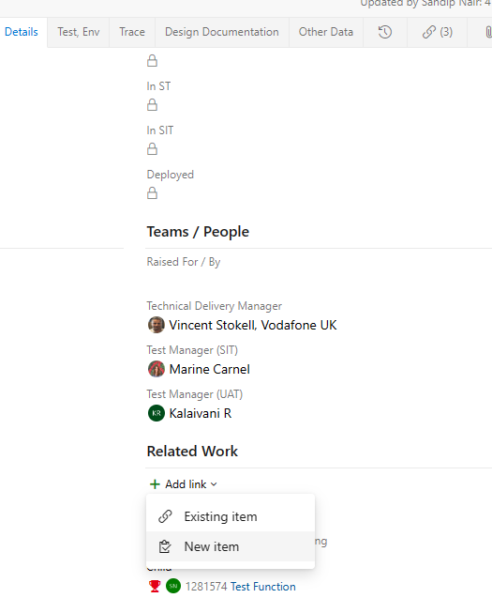
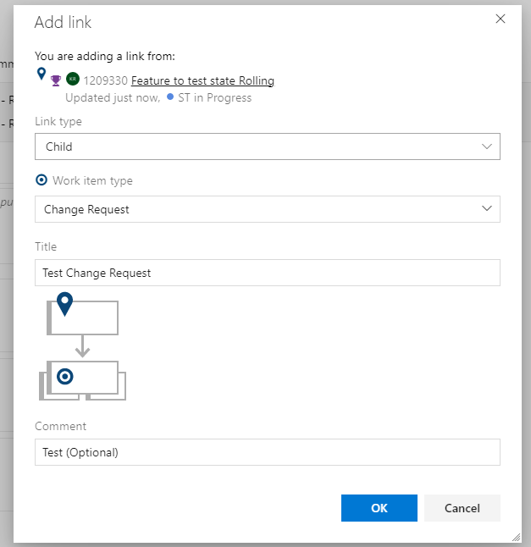
How to create a Change Request #1
Deliveries
Functions
Change Request
A Change Request can be a child of a Delivery or Function, as it may be used by Release Management or Domains.
For Release Management, it must be a child of a Delivery, and optionally (Related) linked to a Function if appropriate
Select the options as below:
Link Type : Child
Work item type: Change Request
Title : an appropriate title of your choice
Comments : (optional) any required comments
Once ready, click OK button
To create a new child change request, on the details tab in the Delivery, click on Add Link → New item.
Notes:
Use screenshots - Marine

Slide 48
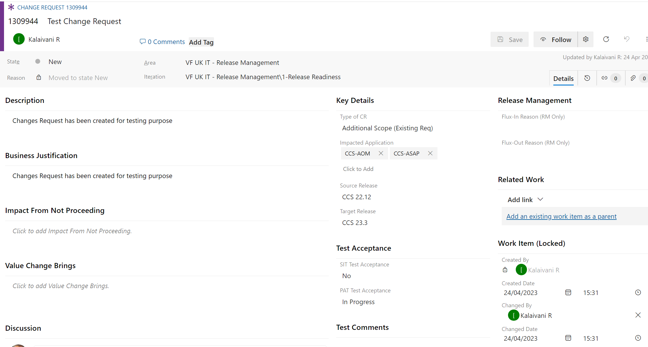
How to create a Change Request #2
Deliveries
Functions
Change Request
Review and update the Key details fields.
Impacted Application is a multi-selectable field (You can select more than 1 application)
Review and update the Description, Business Justification, Impact From not Proceeding and other fields where appropriate
The Work Item group is automatically updated
Select the Source Release or the Target Release as appropriate.
Notes:
Use screenshots - Marine

Slide 49
FUT, CJT & ELS/Hypercare

Slide 50
FUT, CJT & ELS/Hypercare defect alignment with Release
To align an FUT, CJT or ELS/Hypercare defect to any Release, follow the below process:
Delivery Manager MUST raise a Feature (Delivery from CCS 25.1) and align it to a Release to secure Dev and/or SIT Support
All Functions corresponding to relevant application to be raised if dedicated support is required from factory - otherwise no function is required. If there is no dedicated support, CJT defects will follow the BAU process to fix by factory. For hypercare there is no BAU process and dedicated support will be required.
Area and Iteration for the Feature (Delivery from CCS 25.1) to be set as "VF UK IT - Release Management“
As and when identified, Delivery Manager to link the respective Defect Management ADO bugs within the Feature.
Bugs to be created in Defect Management ADO portal as below
Area "Vodafone_CJT_FUT team“ or “Hypercare” to be selected accordingly.
Below fields should be populated and relevant information updated on the ticket before assigning to the appropriate team.
Test Level field - "CJT“, "FUT“ or “Hypercare” to be selected accordingly.
Test Type field - "Customer Journey Testing (CJT)“, "Friendly User Testing (FUT)“ or “Hypercare” to be selected accordingly.
For replication with SIT team assign as below
Area - "VF UK IT-Test And Defect Management\VOIS_SIT Test Team“
Iteration Path "VF UK IT-Test And Defect Management\UK CIT_CCS Releases - FY 24 25\CCS 24.9B"). Note: The release iteration path should be updated based on the release which the project is targeting to deliver the fix.
Overall ownership of the CJT, FUT or Hypercare ADO bugs is with the Delivery Manager, however, they are welcome to join the appropriate daily release call to check the status.

Slide 51
Thank You

